Slide 1
BLE-Based Smart Home Automation System
Abdulwahab Al-Furaidan (222407732)
Abdullah Alnasser (222433435)
Faisal Samer Musallam (222453423)
Supervised by: Dr. Abdullah Al-Buali

Slide 2
The BLE-based smart home automation system uses the ESP32 microcontroller, enabling wireless control of home devices like lights & sensors. By using Bluetooth Low Energy, the system ensures efficient communication with mobile app, providing a seamless smart home experience.
Advantages:
Low-power consumption
Low interference

Slide 3
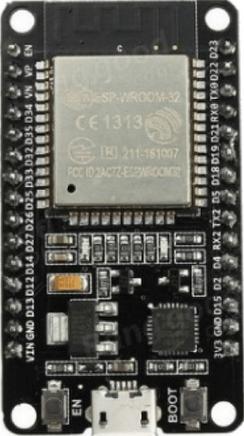
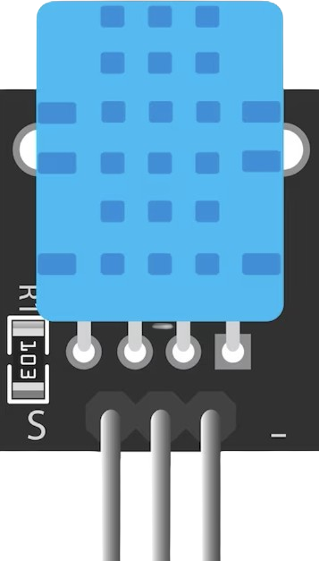
Hardware
ESP32 Microcontroller: Brain of the project. It is a microcontroller with built-in Wi-Fi and BLE. ideal for IoT applications.
DHT11 Sensor: provides temperature and humidity readings to the ESP32.

Slide 4
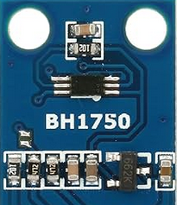

Hardware
BH1750 Sensor: light sensor that measures light intensity in lux. Used to measure if the room is dark or not. We have implemented an automation task where if the ESP32 detects that the room is dark, it will turn on the light automatically.
5V Relay: allows the ESP32 to control high-voltage devices like lights by switching them on or off, while being controlled by low-voltage logic signals from the microcontroller.

Slide 5

Software
Ardiuno IoT Cloud
BLE Application
ESP32 sends data to cloud via Wi-Fi
The application communicates with the ESP32 via BLE

Slide 6
Arduino IoT Cloud Dashboard
The ESP32 can send data to the Arduino IoT Cloud by using the Arduino IoT Cloud library. First, the ESP32 must be configured in the Arduino IoT Cloud platform as a device, where a unique Device ID and secret key are generated. These credentials allow the ESP32 to authenticate with the IoT Cloud. Using the WiFi connection, the ESP32 sends data by defining variables in the Arduino IoT Cloud dashboard that sync with corresponding variables in the ESP32's code.
While the ESP32 collects and publishes data, such as sensor readings, to the cloud. This data can then be monitored or controlled via the IoT Cloud dashboard.

Slide 7
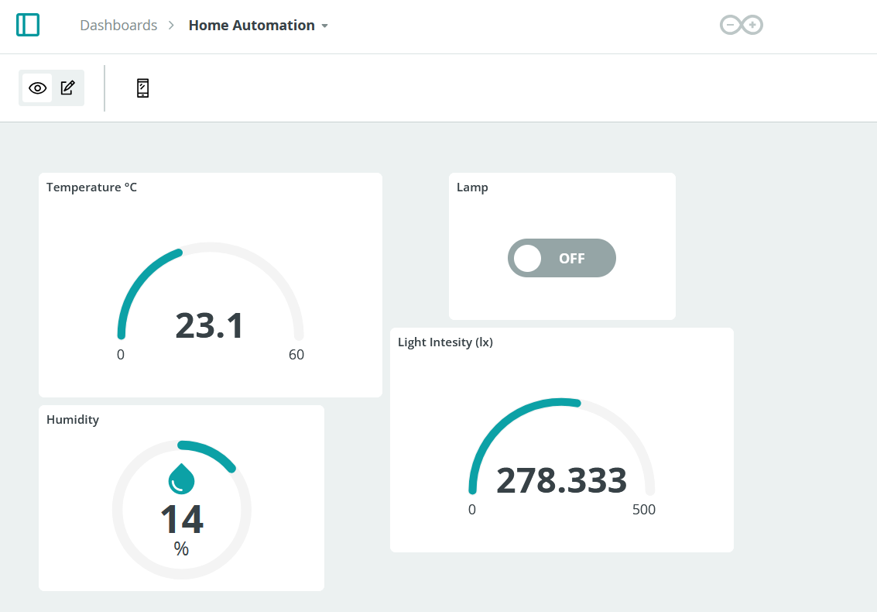
Arduino IoT Cloud Dashboard

Slide 8
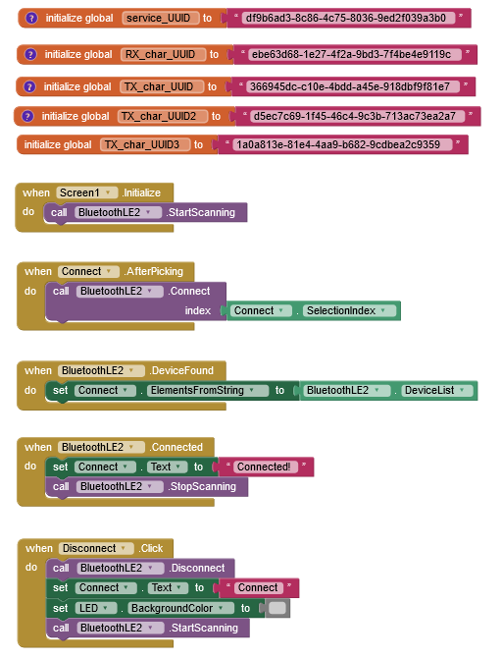
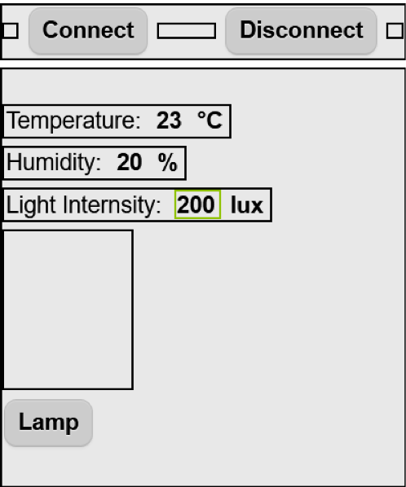
BLE Mobile Application

Slide 9
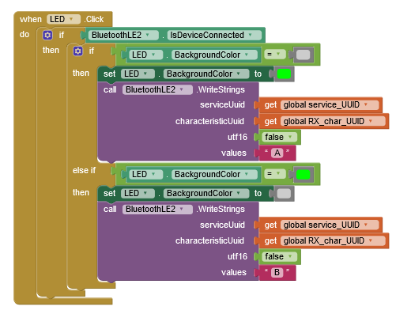
BLE Mobile Application
Create BLE Server.
Create BLE Characteristic for each thing you want to control and assign them NOTIFY, READ or WRITE operations.
Assign values to the Characteristics.
ESP32 sends the values to the app.
Make sure UUID match In code & in the app or the app will not work!

Slide 10
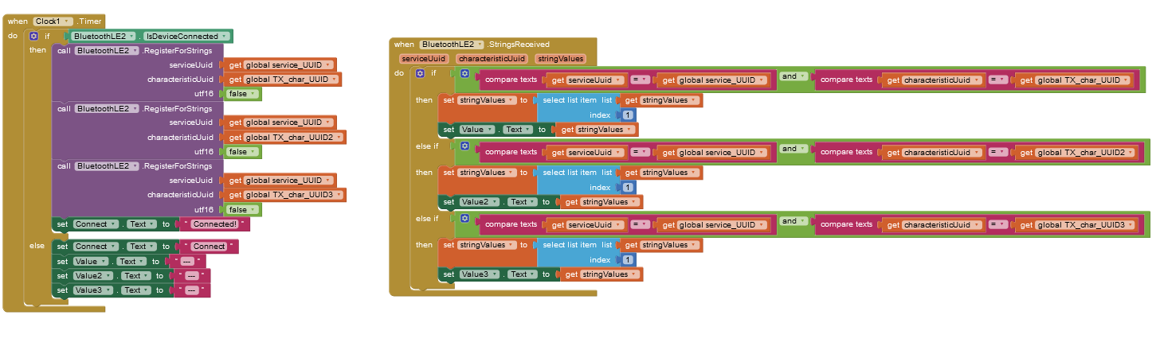
BLE Mobile Application

Slide 11
Thank you for listening.
Do you have any questions?

